Slide 1

Warehouses
Underestimate the Risk
at your Peril
South African Marine Insurance Forum 09th May 2014
Capt Andrew Walker

Slide 2
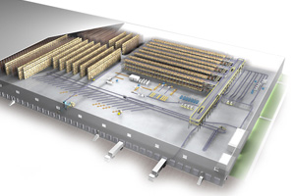
AGENDA
Negative Impact of a loss
Warehouses - What are the risks
The requirements of a survey
Questions

Slide 3



Cargo Loss, Theft or Damage –
The Negative Impact
Financial impact on the enterprise
Operational impact on the enterprise
Loss of market
Loss of sales
Interruption to cash flow
Potential increase in insurance premium
Increased administrative costs
Interruption to supply chain
Damage to reputation
(with customers and within the industry)
Tension in relationships with customers
and suppliers
Personnel frustration and loss of morale
Loss of brand image

Slide 4

Warehouses .......
What are the Risks ?
Are you prepared to Gamble?

Slide 5


Ignore the Risk Exposures at your Peril
Natural Catastrophic Loss
Fire
Construction
Theft
Logistic
Fraudulent pick up

Slide 6

Natural Catastrophic Loss

Slide 7
Natural Catastrophes
Changing climate conditions have added to the unpredictability and frequency of natural disasters, increasing the uncertainty behind future trends and exposures
Source: USGS Fact Sheet 2001-3008, January 2011

Slide 8
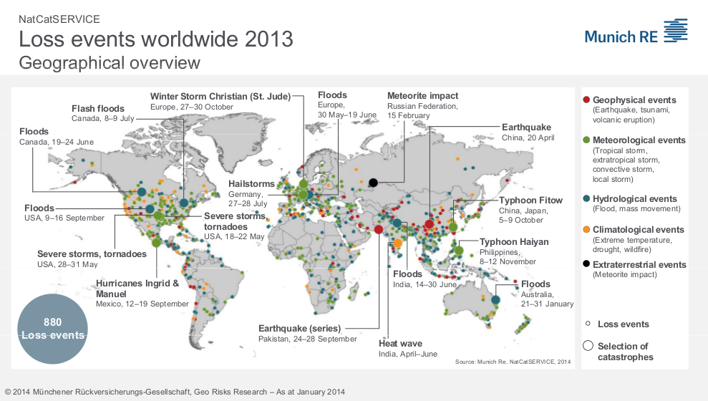
2013 Natural Catastrophes World Map

Slide 9

Natural Catastrophes
Geophysical Events - Earthquake , Tsunami , Volcanic Eruption
Meteorological Events – Tropical Storms ,extratropical storms ,convective storm, Local storms
Hydrological events - Flooding , mass movement
Climatological events – Extreme temperature , drought , wildfire
Extraterrestial events – Meteorite impact

Slide 10
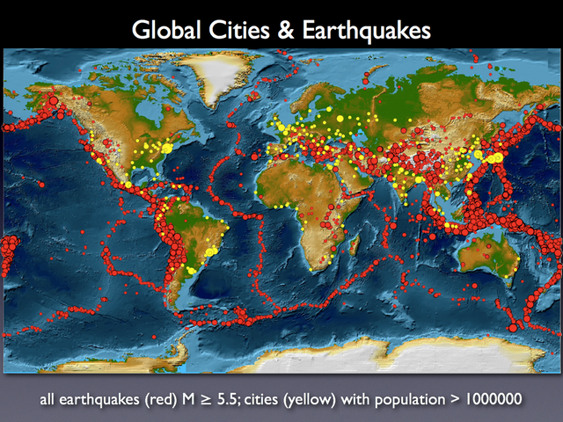
Earthquake risk

Slide 11
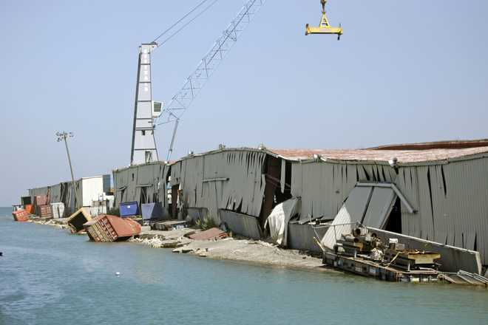
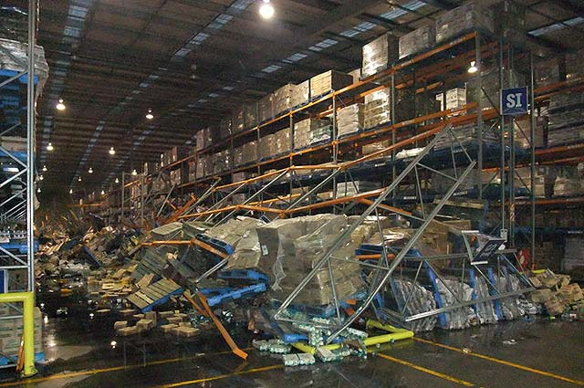
Earthquake Risk
Is the area prone to earthquakes
Does the warehouse comply with regional regulations in high risk areas
Are the storage racks able to withstand a degree of earthquake activity
Is the area at risk of Tsunamis – proximity to the coast

Slide 12
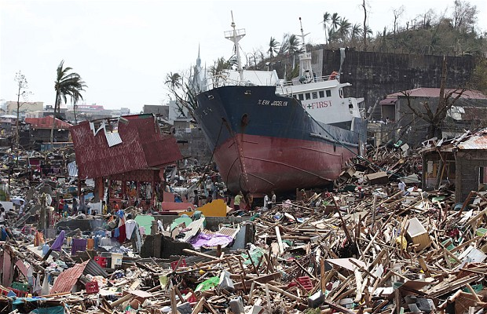
Philippines Nov 2013 Typhoon Haiyan

Slide 13
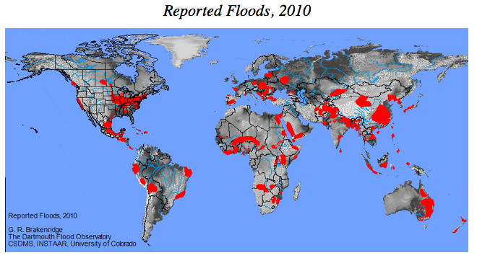
Flooding Risk

Slide 14
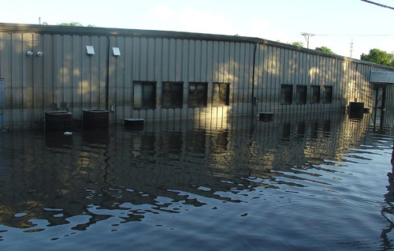
Flood Risk
Proximity to river systems, lakes,dams , marshes and canals
Proximity to the coast – Storm surges
Geographical positioning :- Elevation , mudslide risk area
Structure - Drainage systems ( Roof and ground facility ) and if warehouse flooring is raised.
Stock should be stored at least 150mm clear of the floor to prevent water damage.
Is emergency equipment such as portable pumps and accessories readily available with knowledge of use.

Slide 15

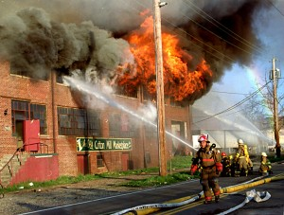
Warehouse Fire Risk

Slide 16
Understanding Fire Risk
Many of the most costly fires occur in warehouses and storage areas, where often a high fire risk is combined with high values and/or a high business dependency.
In recent years the fire risk associated with warehouses and storage areas has been exacerbated by the increasing use of combustible packaging, including expanded plastics and the move to ever larger and higher warehouses with increasing levels of automation and limited compartmentation.
.

Slide 17
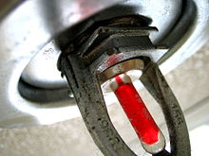
Understanding Fire Risk
The only proven method of controlling a warehouse fire is with properly designed and maintained automatic sprinkler systems. If sprinkler protection is not provided, the likelihood of controlling a fire in a warehouse is minimal, at best.

Slide 18
Experience of warehouse fires shows that extensive damage occurs as a result of factors such as the following:
Late discovery of the fire.
Rapid fire spread.
Inadequacies in storage space layout and design.
Lack of compartmentalisation.
Bad housekeeping.
A disproportionate amount of stored goods.
Generation of a high level of toxic fumes and gases.
Absence of automatic sprinklers.
Absence of a damage reduction and action plan in the event of emergency.

Slide 19
Warehouse Fire Risk
In order to understand the nature of the fire risk presented by warehouses and storage areas it is necessary to understand the key features associated with storage and their impact on both the rate of fire inception and fire spread i.e.
Commodity Classification
Storage Configuration
Storage Height

Slide 20

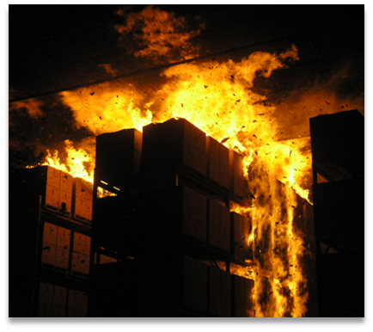
Fire Risk
Commodity Classification
For fire protection purposes goods stored, including their packaging are classified according to their combustibility i.e. their rate of combustion, rate of heat release and rate of flame spread.
It is critically important to properly identify the correct commodity class, as this will serve as the foundation for determining the appropriate fire sprinkler protection scheme.

Slide 21
Fire Risk
Storage Configuration
From a fire protection viewpoint storage is divided into 4 main types – bulk storage, solid piling, palletized storage and rack storage.
Bulk Storage – consists of piles of unpackaged material in loose free flowing condition such as powders, granules, pallets or flakes – these are typically found in silos, bins, tanks or in large piles, on the floors of storage buildings.
Solid Piling – consists of cartons, boxes, bales, bags etc in direct contact with each other.
Palletised Storage – consists of unit loads mounted on pallets.
Rack Storage – consists of a structural framework into which unit loads (usually on pallets) are placed. Rack storage can be further classified into single row, double row, multiple row and drive through racks plus specialist rack storage systems such as automated storage and retrieval systems and storage carousels.

Slide 22
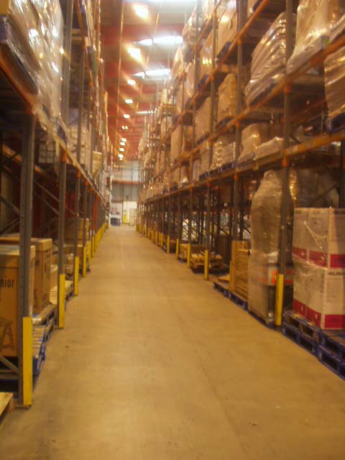
Fire Risk
Storage Height
In the event of a fire the height to which goods are stored will have a significant influence on the rate at which the fire will spread and in the difficulty of achieving fire control.
Whilst limitations imposed by stability requirements limit the storage heights associated with bulk storage, solid piling and palletized storage this is not the case with rack storage and storage heights in excess of 13 metres (40 feet) are not uncommon.

Slide 23

Fire Risk Management
Fire risk assessment to identify the fire hazards present, including an assessment of the goods stored and the adequacy of the controls in place.
Procedures should be in place at the goods receiving stage to correctly identify the goods concerned and ensure that they are located in the correct area(s).
Review storage arrangements to ensure that these provide for clearly defined storage areas with adequate aisles between them
Where automatic sprinkler protection is installed it is essential that adequate clearance is maintained between sprinkler heads and the top of the stored goods below.

Slide 24
Fire Risk Management
Establish effective housekeeping arrangements to ensure that clear aisles are maintained at all times and prevent build up of combustible waste inside the warehouse / storage area.
A system of regular self-inspections should be established to ensure that housekeeping disciplines are being maintained and that fire protections remain in place and fully functional – weekly inspections are recommended and to be documented.
Ensure that all fixed electrical installations and portable electric appliances are the subject of adequate periodic inspection and maintenance in accordance with regulations for the region.
All hot work should be the subject of an adequate permit to work system and to be documented with good record keeping

Slide 25
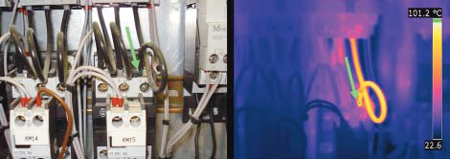
Fire Risk Management
Ensure that adequate smoking controls are in place and are fully complied with.
Review fire emergency planning arrangements to ensure that all staff are adequately trained in the actions to take in the event of a fire, including fire evacuation procedures and the use of portable fire extinguishers.

Slide 26
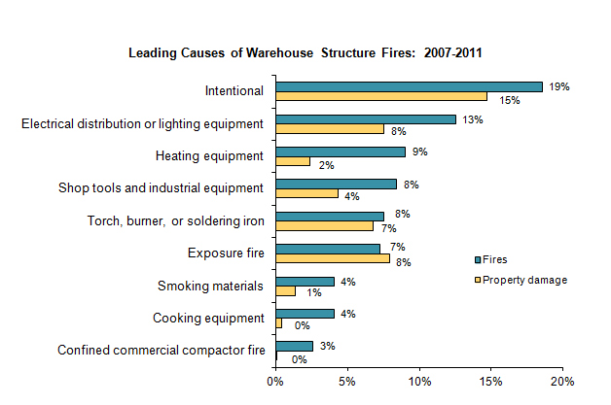
Fire Risk

Slide 27
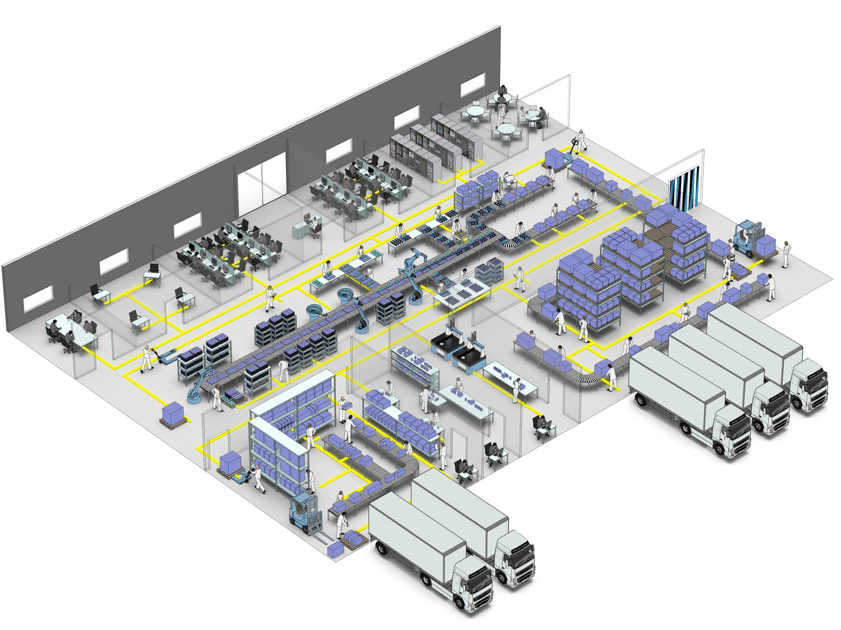
Warehouse Construction

Slide 28
Construction of Warehouses
Warehouse and storage buildings should preferably comprise detached buildings with adequate spatial separation from adjacent buildings. Where this is not practicable warehouse and storage areas should be effectively fire separated from all adjacent areas in particular production areas.
Internal fire walls between adjacent warehouse / storage areas and between warehouse / storage areas and production areas should be of at least 4 hours fire-resistance or 2 hours where the areas on both sides of the wall are adequately sprinkler protected.
Plant rooms e.g. electrical substations / switch rooms, boiler rooms etc should be adequately separated from the main warehouse / storage area preferably by fire walls of at least 2 hours fire -resistance

Slide 29
Construction of Warehouses
Heaters should be preferably of the fixed black heat type sited at least one metre clear of stock and where floor mounted within a substantial fixed metal barrier
Warehouses and storage areas should be fully protected by an adequate automatic sprinkler system installed WITH ADEQUATE BACK UP WATER SUPPLY
The water storage supply should last between 60-90 minutes depending on the type of sprinkler system
Warehouses and storage areas should be fully protected by an automatic fire detection system
Adequate water supplies should be available for use by the fire brigade for fire-fighting purposes.

Slide 30
Construction of Warehouses
The use of high intensity discharge lighting inside warehouse / storage areas should be avoided unless of an approved type with a shroud to protect the lamp’s arc tube and a non-combustible external containment barrier enclosing the whole of the lamp unit
Adequate numbers of suitable portable fire extinguishers should be available for fire-fighting purposes.
Warehouse / storage areas should be provided with adequate security arrangements

Slide 31
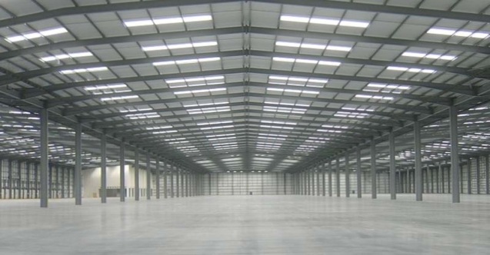

Warehouse Security

Slide 32
Security – Cargo Theft Risk
Mexico, Brazil, South Africa, United States, Russia, India and United Kingdom are the countries most at risk for cargo theft globally

Slide 33

Warehouse Security
Warehouse theft constitutes between 5 to 10% of the value of all cargo thefts. Although small in comparison to Road transport theft , tend to be very costly.

Slide 34

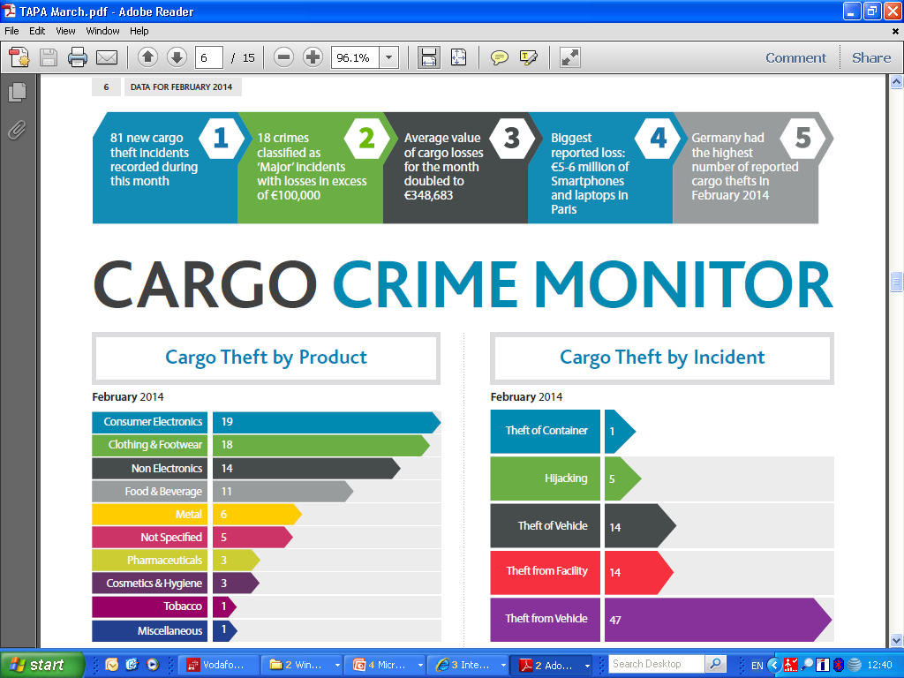
Warehouse Security

Slide 35
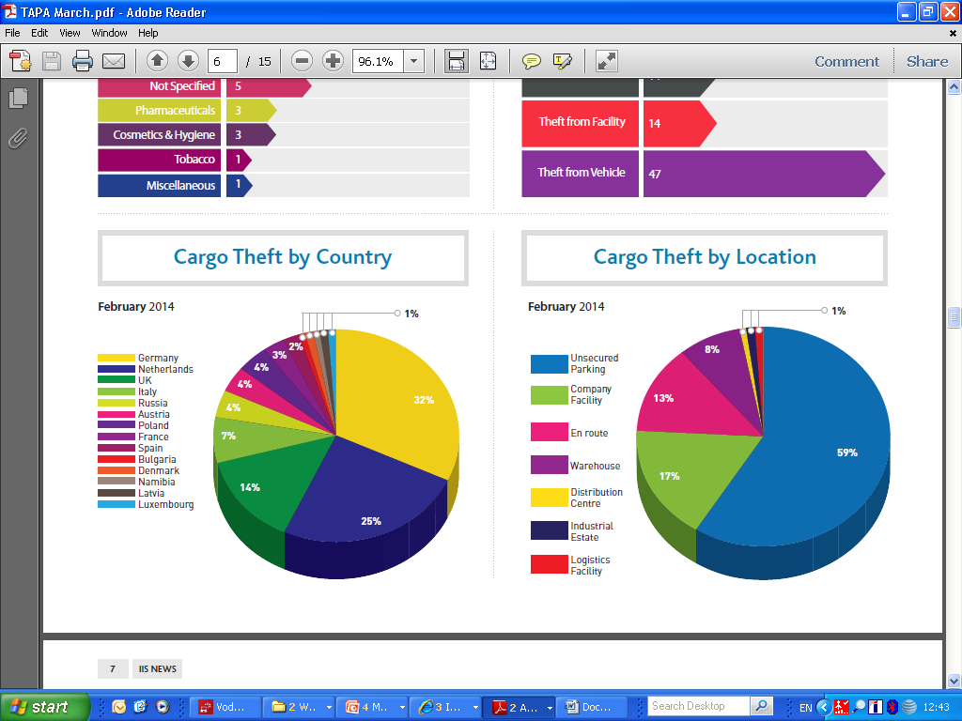
Warehouse Security

Slide 36

Ware House Security
Fraudulent Pick up
Making up” a trucking company which actually has no place of business, no legal status, but arrives with a truck which appears legal
Using the licenses and registration of an existing company by obtaining documents, such as letterhead, driver IDs, uniforms, logo, truck decals
Redirection of drivers to deliver to alternate locations, usually by use of “fake” gate guards or some sort of communication, then receiving the goods at the alternate location as if it was the correct destination
Use of the documentation of a real carrier which has ceased operation
Actual creation of a trucking company with all of the proper licenses and insurance strictly for the purpose of diverting freight

Slide 37

Warehouse Security Issues
Environment and Geography
History of the area and the facility
Degree of Risk
Value of Risk (to whom?)
Resiliency and criticality
Who is protecting the Warehouse?
Logistics – who decides and how are you protected

Slide 38
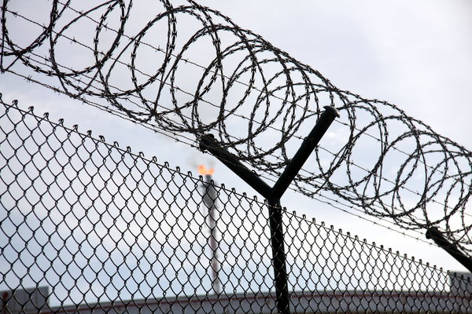
Warehouse Security
Security Aspects to be Aware of :
Location in relation to population demographic
Access roads – Clear of thick side vegetation, good condition
Type of fencing
Security Gate well managed
Security company utilized
Security monitoring – what level
Distance of warehousing from perimeter fence
Access control to Warehouse – deliveries and administrative
Access doors - secure and tamper proof externally
Lighting
CCTV
Roof access / security
Visitor security protocols

Slide 39
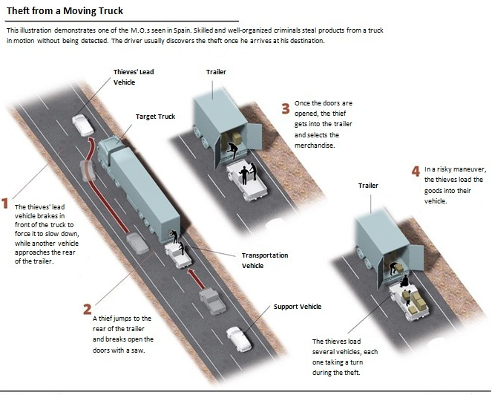
Emerging Cargo Theft MO in China

Slide 40
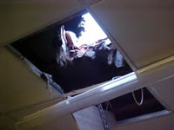
Roof Jobs

Slide 41
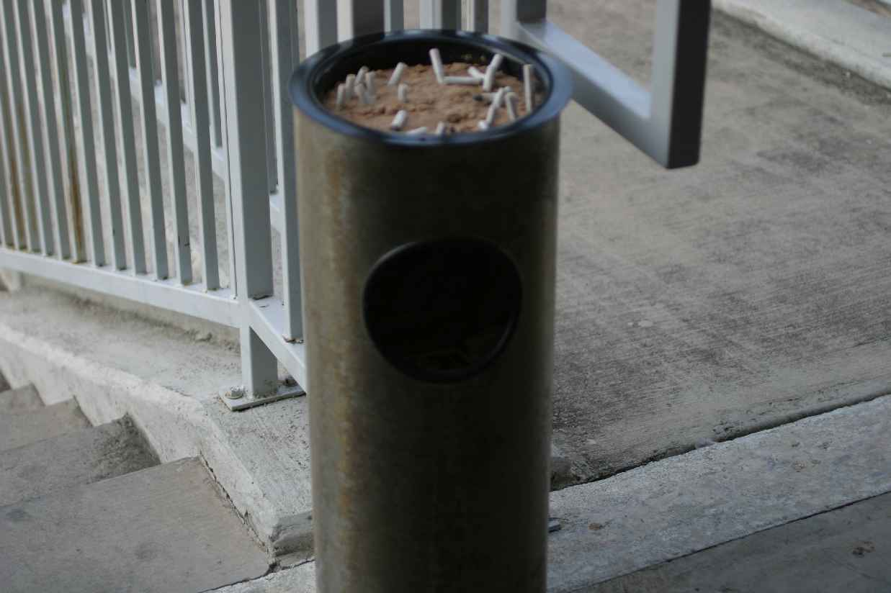
Alarm System Bypass
A camera was placed in this ashtray and pointed at the keypad!
TOMCATS Photo

Slide 42
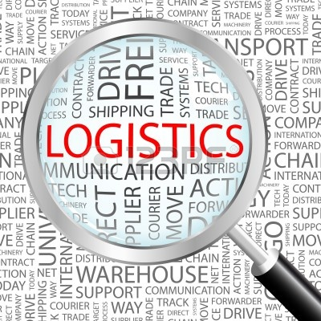
The Need for a Survey

Slide 43

The Need for a Survey
Type of Risk Assessments
Stock
Stock throughput (STP)
Warehouse keepers liability

Slide 44
The need for a survey
Why do Risk Assessments and Surveys ?
Provides the underwriter with information about the risk
Underwriter to decide whether to write the risk
Another set of eyes looking at the site
A static value and thus at risk for theft, fire and flooding etc.
High value at times
Reduce the risk at the site for the benefit of customers requiring the goods
Provide risk requirements to improve the risk
Could be referred to by claims personnel

Slide 45
THANK YOU
American International Group, Inc. (AIG) is a leading international insurance organization serving customers in more than 130 countries and jurisdictions. AIG companies serve commercial, institutional, and individual customers through one of the most extensive worldwide property-casualty networks of any insurer. In addition, AIG companies are leading providers of life insurance and retirement services in the United States. AIG common stock is listed on the New York Stock Exchange and the Tokyo Stock Exchange.
AIG is the marketing name for the worldwide property-casualty, life and retirement, and general insurance operations of American International Group, Inc. Products and services are written or provided by subsidiaries or affiliates of American International Group, Inc. Not all products and services are available in every jurisdiction, and insurance coverage is governed by actual policy language. Certain products and services may be provided by independent third parties. Insurance products may be distributed through affiliated or unaffiliated entities. Certain property-casualty coverages may be provided by a surplus lines insurer. Surplus lines insurers do not generally participate in state guaranty funds and insureds are therefore not protected by such funds.

